Slide 1

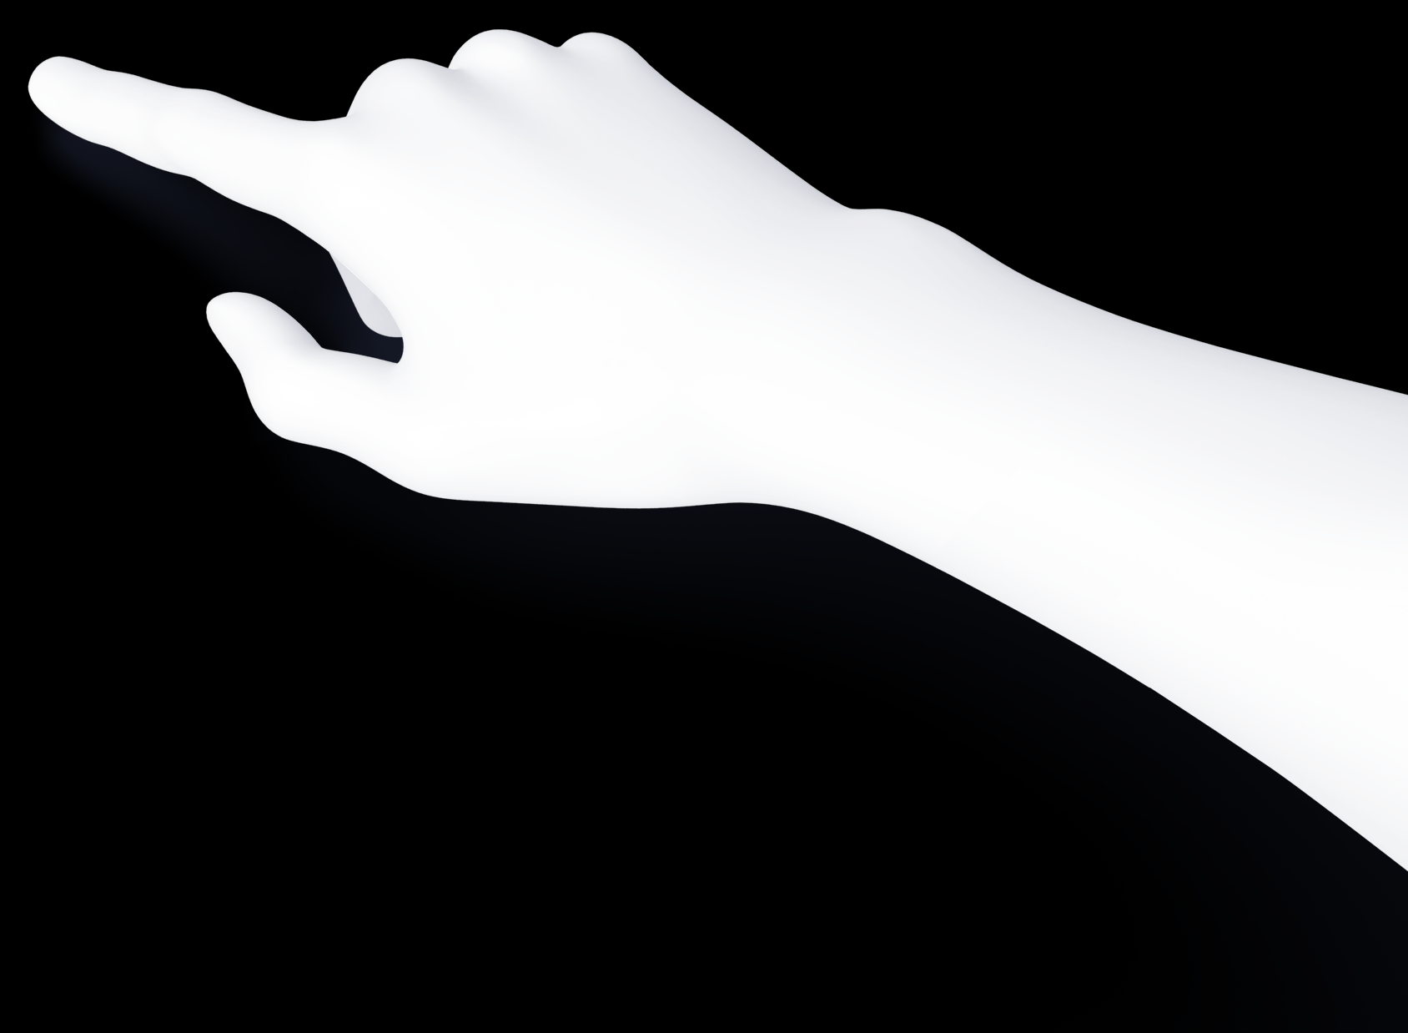
Variables
A variable is like a small storage box in your computer where we keep data.
01
Name
So, we can refer it later.
02
Type
Like a number or string.
03
Value
The actual data that store in it.
20
60

Slide 2
earth_weight = 70
name
value
type
earth_weight
70
int

Slide 3
Type Casting
converting a variable from one data type to another.

Slide 4
“123.45”
123.45
123

Slide 5
“An earthling's weight on Mars is 37.8% of their weight on earth. Write a Python program that prompts the user (an earthling) to enter their weight on earth and prints their calculated weight on Mars.”

